Slide 1

Problem in Brief
Difficulty in moving the patient without the assistance.
Lack of enough people to care for older people and handicapped people (whose limbs are not strong) at homes.
Risk of leaving the patient at home alone.
Patients with physical injuries and disabilities has becomes a day-to-day scenario. (Due to accidents, health problems etc.)

Slide 2
Project Aim
Create a voice-controlled wheelchair for handicapped people and elderly people whose limbs are not strong and cannot move on their own at homes.
Objectives
To help the people who are dependent on wheelchair for their mobility
Able to move desired location without depend on the assistance.
Reduce the effort to control the wheelchair.
Ensure the safety during the movement.
Design and development of prototype suited to these needs.

Slide 3
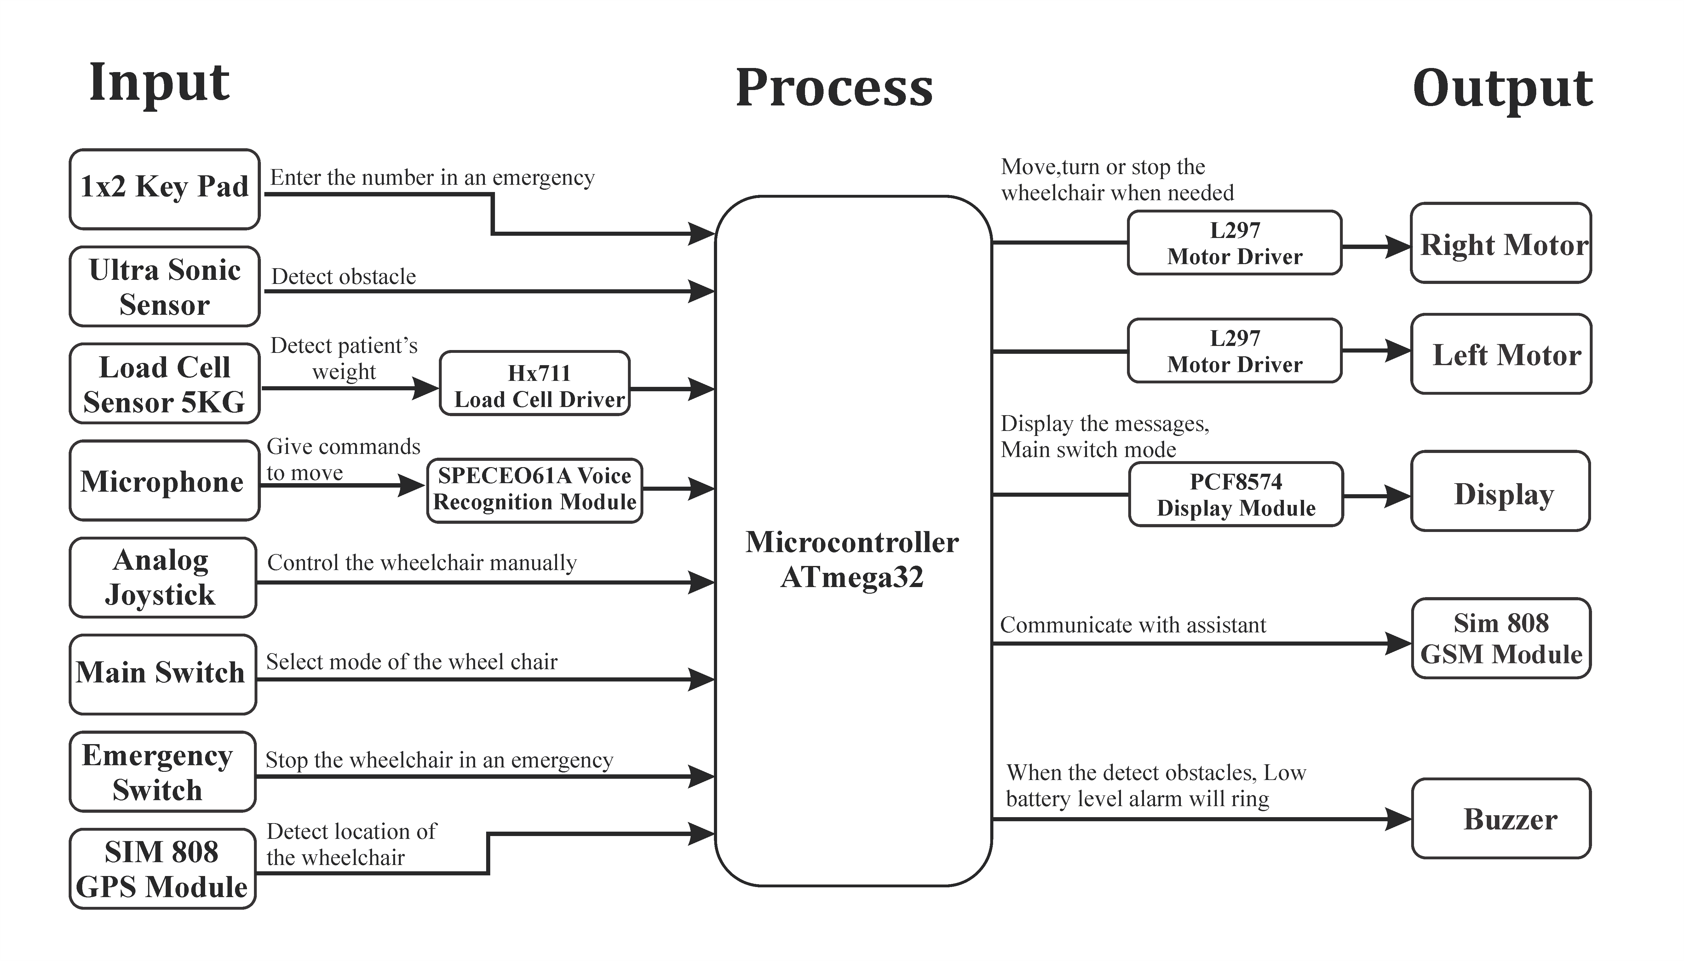
Proposed Solution

Slide 4
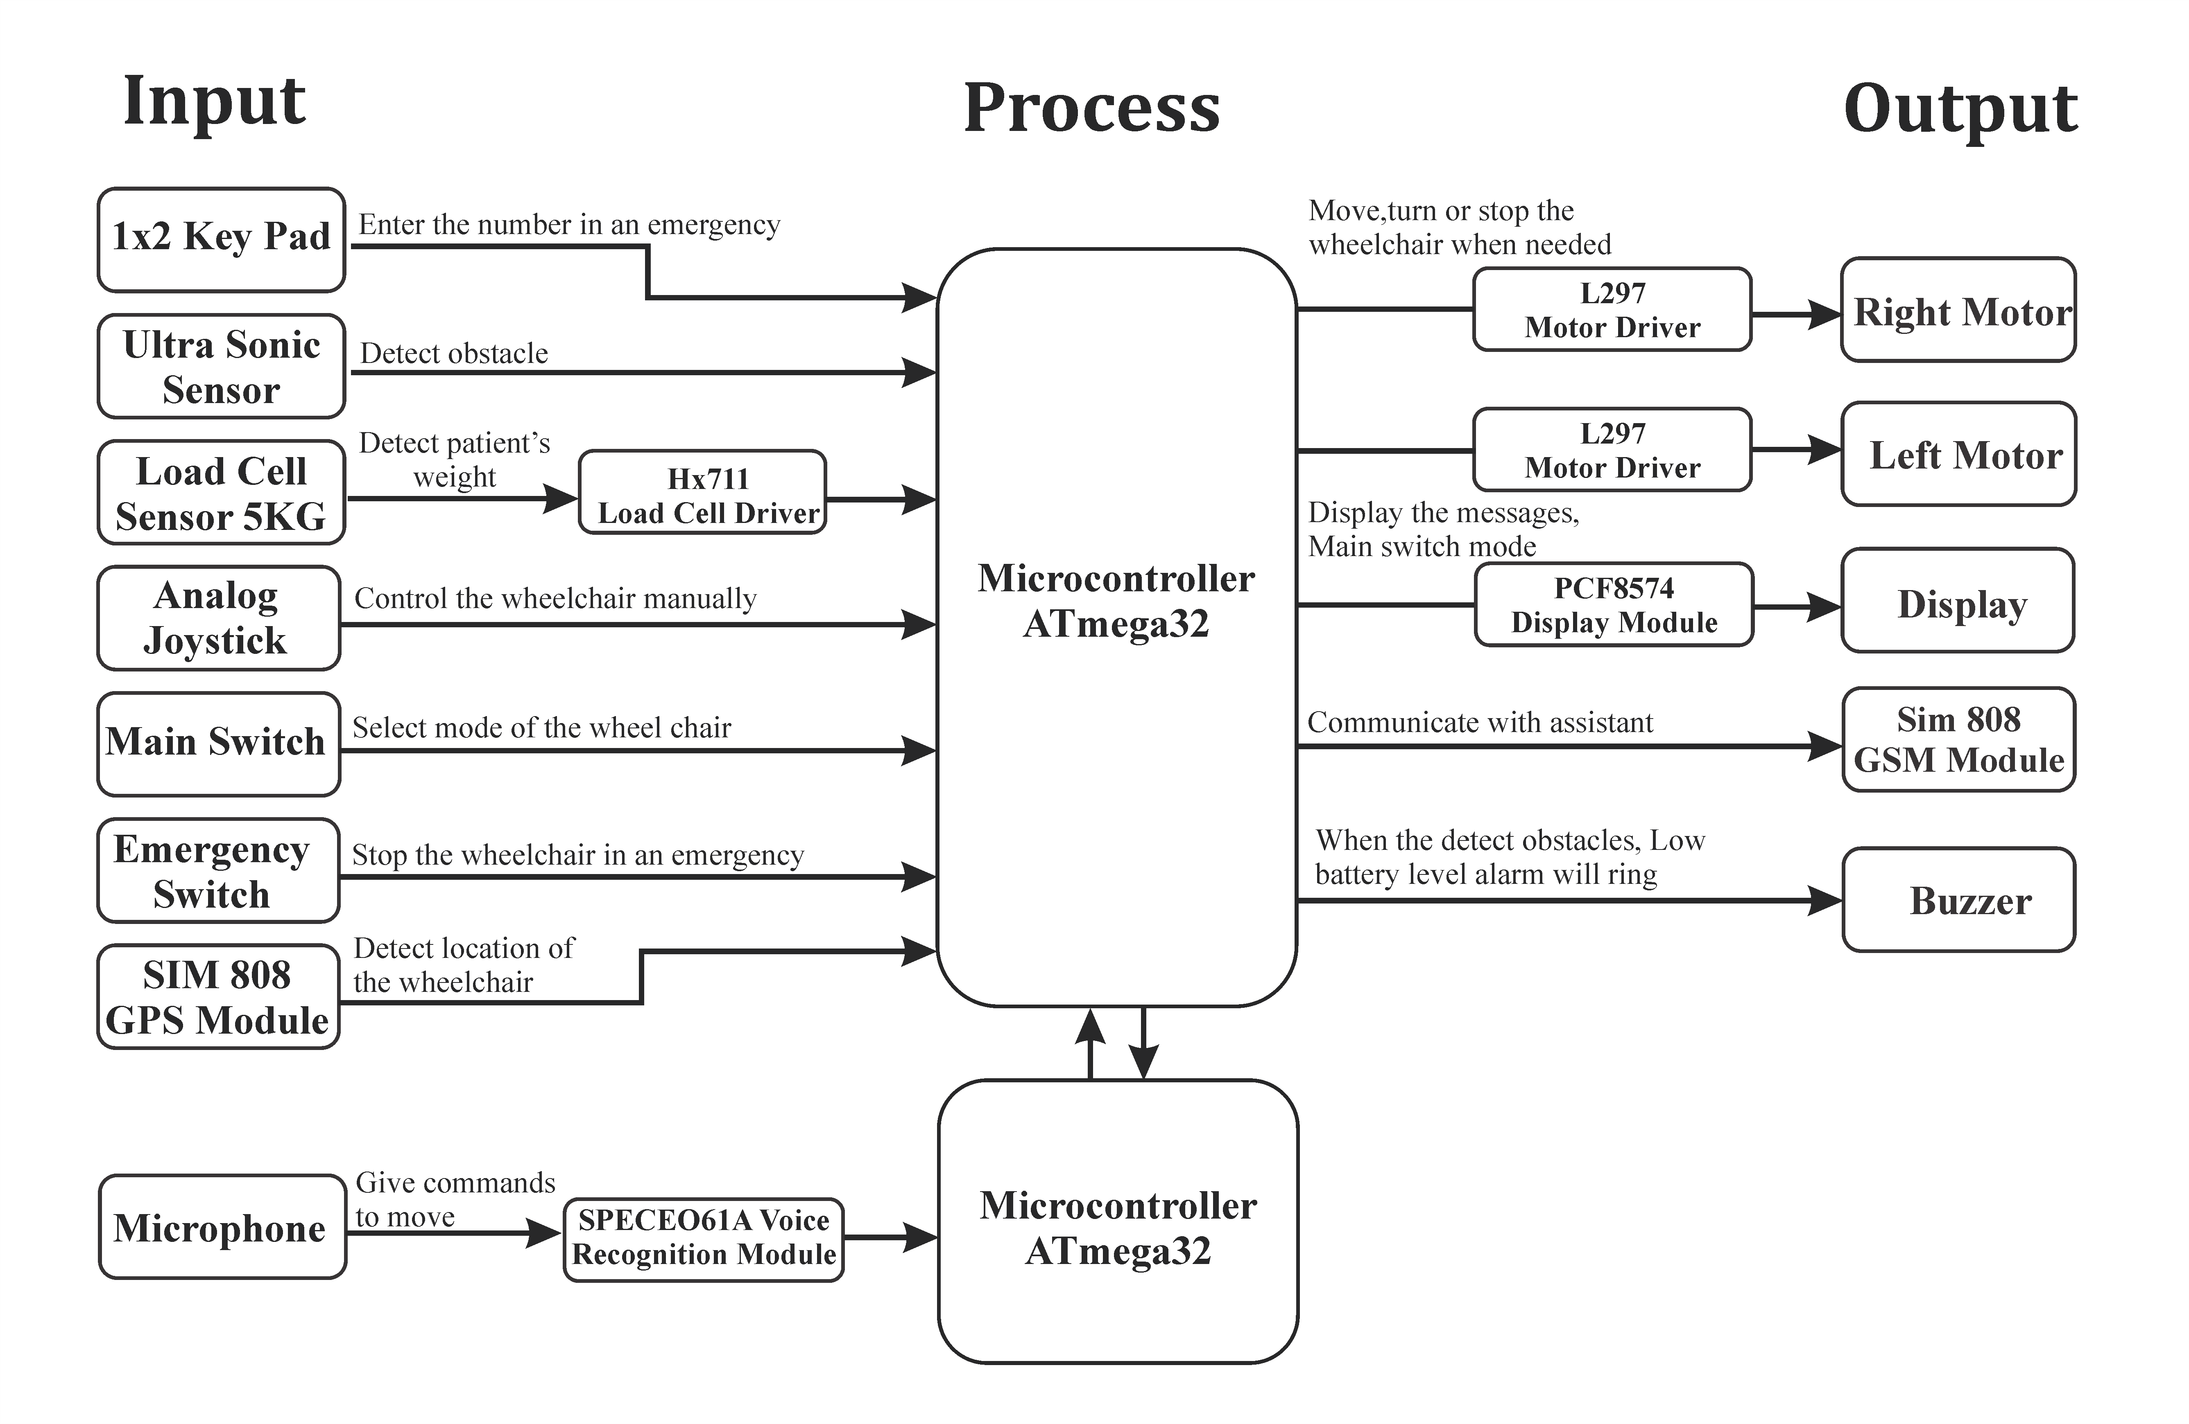
Circuit Diagram

Slide 5
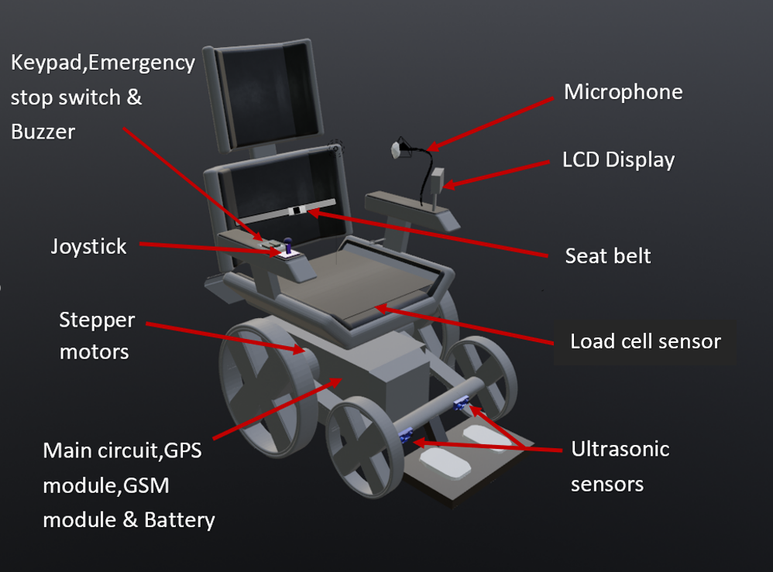
3D View of Smart Wheelchair

Slide 6
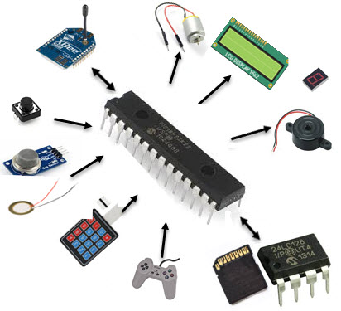
Resource Required
Software
Microchip Studio
Proteus
Hardware
Atmega32 Microcontroller
SPCE061A Voice recognition Module & Mic
Load Cell 5kg
Hx711 Load Cell Driver
Ultrasonic Sensor
Keypad
3-way Switch
Push Button
Joystick Module
Nema17 Stepper Motor
16x2 LCD Display
PCF8574 Display Module
Buzzer Module
Battery(12v)
L297 Stepper Motor Driver
SIM808 GPS GSM Module

Slide 7
Cost Estimation
 | Name | Quantity | Price
1 | Atmega32 Microcontroller | 2 | 1200.00
2 | SPCE061A Voice recognition Module & Mic | 1 | 4450.00
3 | Load Cell 5kg | 1 | 800.00
4 | Hx711 Load Cell Driver | 1 | 215.00
5 | HC-SR04 Ultrasonic Sensor | 2 | 450.00
6 | Keypad | 1 | 150.00
7 | 3-way Switch | 1 | 20.00
8 | Push Button | 1 | 50.00
9 | Joystick Module | 1 | 140.00
10 | Nema17 Stepper Motor | 2 | 2980.00
11 | SIM808 GPS GSM Module | 1 | 2600.00
12 | 16x2 LCD Display | 1 | 500.00
13 | PCF8574 Display Module | 2 | 400.00
14 | Buzzer Module | 2 | 200.00
15 | Battery(12v) | 1 | 2000.00
16 | L297 Stepper Motor Driver | 2 | 600.00
17 | PCB, Bread Board, Jumper Wires, Structure & Others |  | 2500.00
Total |  |  | 19255.00

Slide 8
Test and Implementation

Slide 9
01.
In this project, I was assigned to study the ultrasonic sensor and the GSM module. The ultrasonic sensor detects obstacles and avoids them, and the GSM module communicates with the assistant. So far, I have studied the ultrasonic sensor.

Slide 10
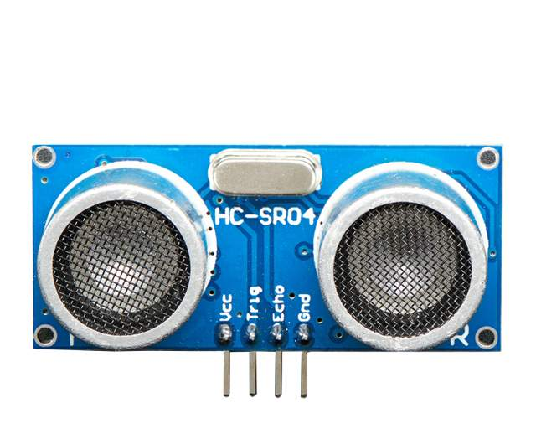
HC-SR04 Ultrasonic Sensor
Specifications
Ultrasonic Wave
Transmitter
Ultrasonic Wave
Receiver
Working Voltage | DC 5V
Working Current | 15mA
Working Frequency | 40Hz
Max Range | 4m
Min Range | 2cm
Vcc
Ground Pin
Data Sheet of HC-SR04
Trigger Pin
Echo Pin

Slide 11
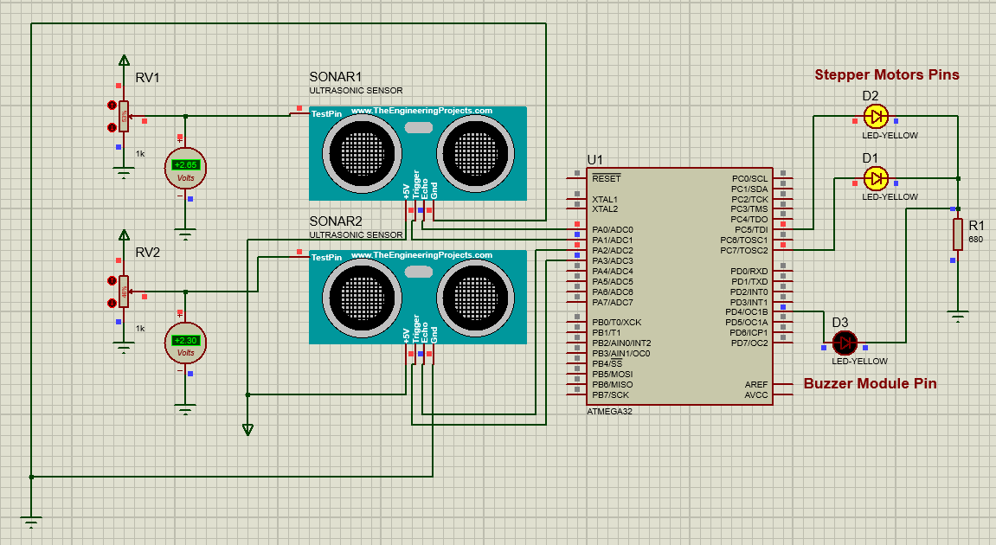
Ultrasonic Sensors Circuit Diagram

Slide 12
02
The part that was specified to me is the LCD, Keypad, Buzzer and Load senser.
In the interim evaluation I mainly studied about LCD and Keypad. In this case we are going to connect a 1x2 matrix keypad and a 16×2 LCD to an Atmega32 microcontroller.
1x2 keypad-
number 1- when the patient has an emergency
number 2 - when the patient receives messages from assistant

Slide 13
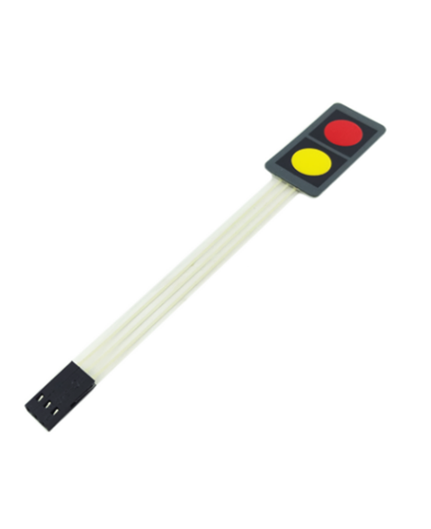
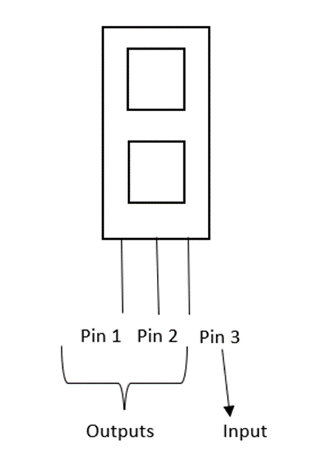
1x2 keypad
This device has 3 pins. One for input and other two for outputs
Specifications
1. Key Type: 1x2. 2. Voltage: DC 12V. 3. Current：30mA. 4. Contact Resistance：>=100 Ohm. 5. Force：250-350g. 6. Contact Bounce：>1s. 7. Pad Size：40 x 20 x 0.8mm/1.6'' x 0.8'' x 0.03''(L*W*T) 8. Cable Length：72mm/2.8''. 9. Connector Pitch：2.54mm/0.1''. 10.Material：Plastic.

Slide 14
16x2 LCD
The next part is LCD screen. LCD display is the output of the keypad.
•The 16x2 LCD will have a total of 32 characters, 16 on the first line and 16 on the second.
Display the Main switch mode
Voice controlled mode
Joystick mode

Slide 15
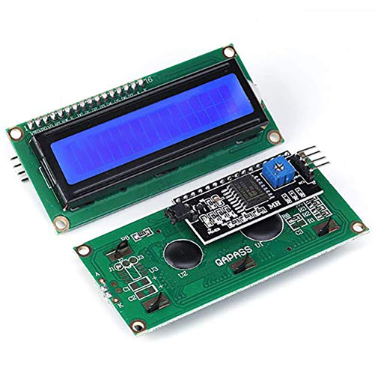
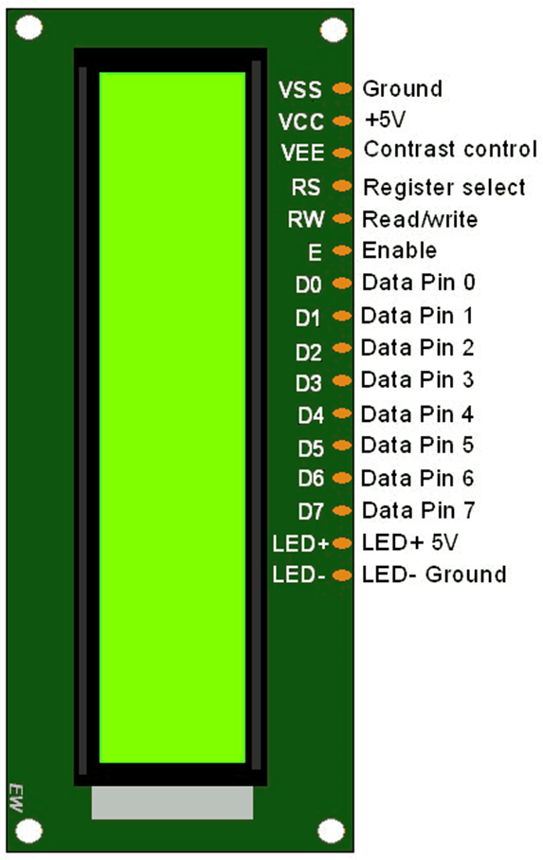
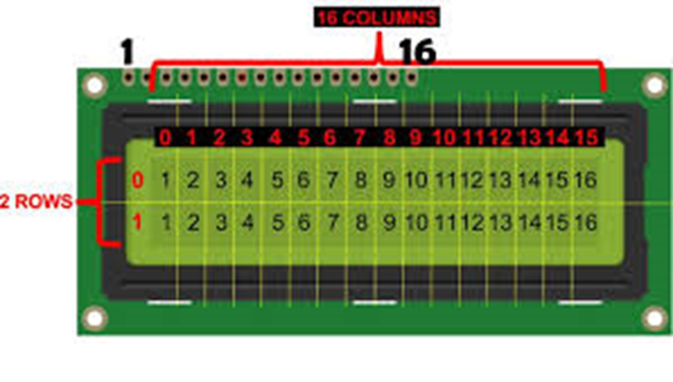
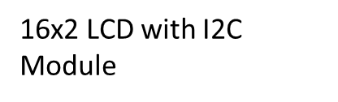

Slide 16
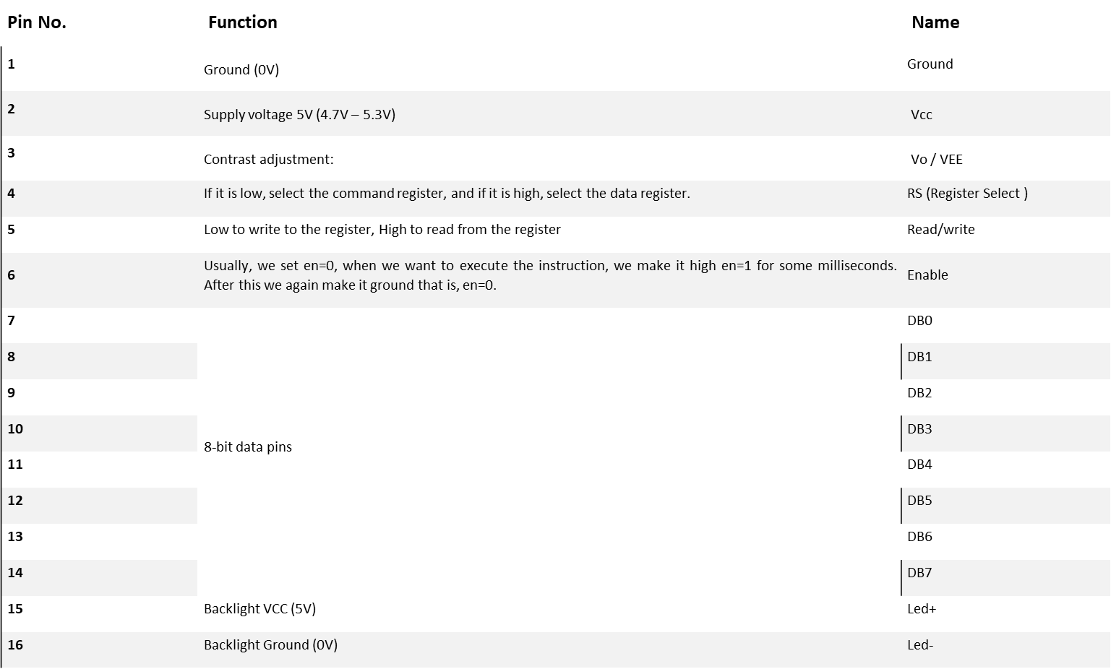

Slide 17
Specifications
Minimum logic voltage 4.5V
Maximum logic voltage 5.5V
Typical LED blacklight voltage drop 4.2V
Typical LED blacklight current 120mA
Supply current 2mA
Size: 85.0 x 29.5 x 13.5 mm
Viewing area: 64.5 x 16.4 mm
Dot size: 0.56 x 0.61 mm
Character size: 3.00 x 5.23 mm
Weight: 35 g
https://components101.com/displays/16x2-lcd-pinout-datasheet

Slide 18
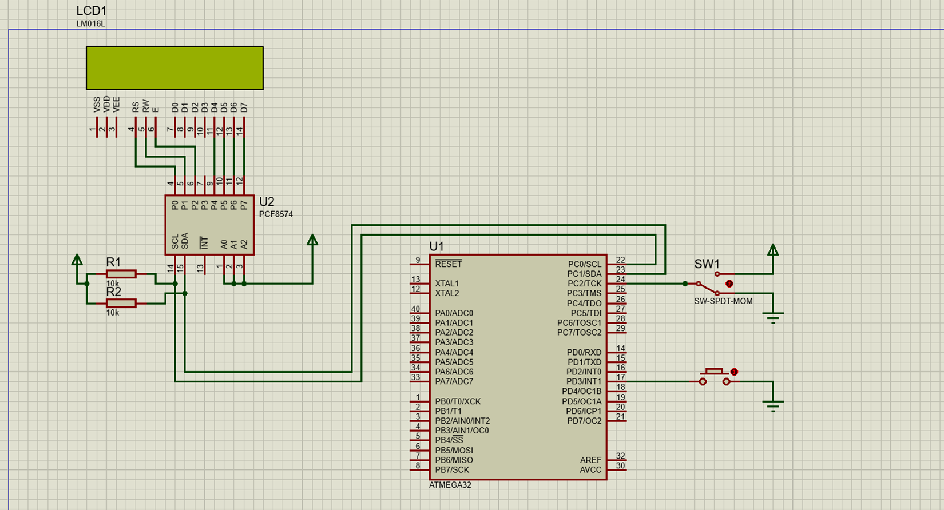
LCD And Keypad Circuit Diagram

Slide 19
03.
In Our Project, My Responsibility is to study and Implement the GPS Module And the Voice Recognition Module. Here, we use voice recognition Module to Move the wheelchair. There, The voice command is given with the help of a microphone. The GPS module is used to identify the location of wheelchair. At the Moment, I have Studied GPS Module.
• How GPS Works
• Pin Description
• Specification

Slide 20
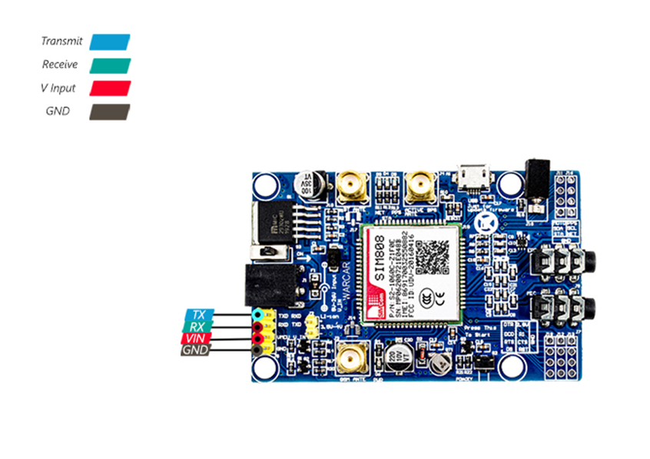
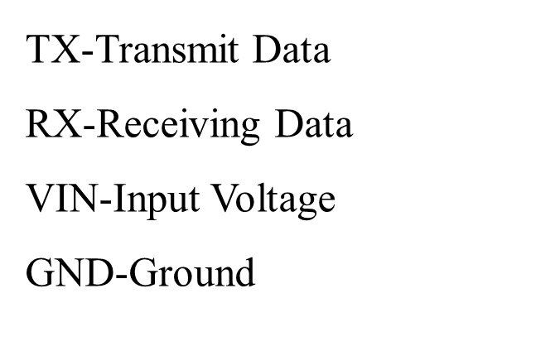
SIM808 GPS GSM Module

Slide 21
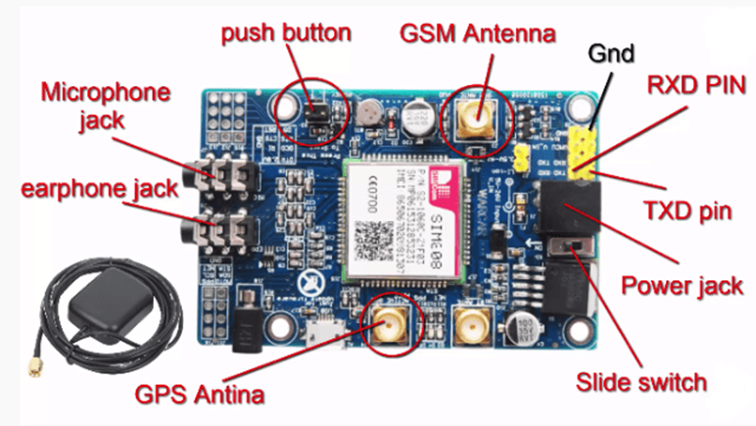
Specification
Specifications
•Input Voltage-3.7V(power through Li-Ion Battery)
•Current Requirement-<600mA
•Baud Rate (Default) -9600bps
•At Command Interface
•GPS & GSM Antenna
•Insert an unlocked Micro Sim card to SIM Card holder.
Data Sheet of SIM-808 Module

Slide 22
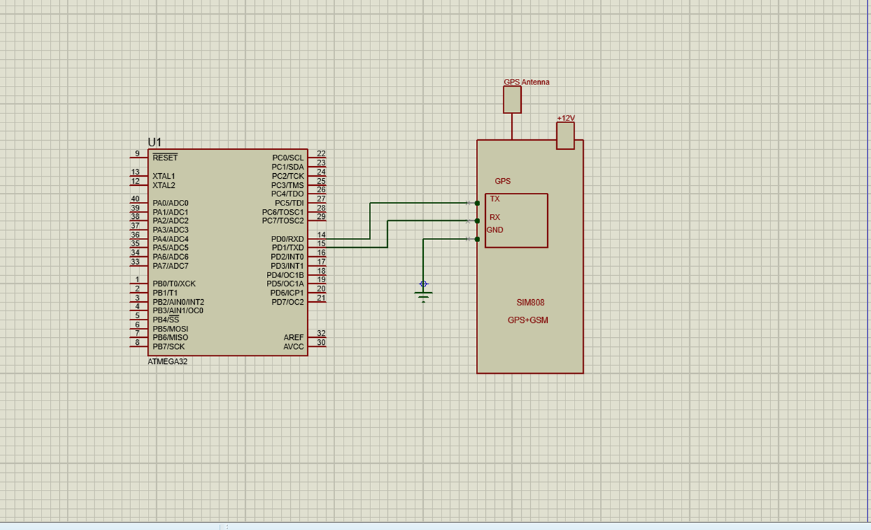
SIM808 GPS Circuit Diagram

Slide 23
04
The area that was allocated to me is the joystick controller. Joystick is an input device. Joystick has combination of two Potentiometers and a push button. The joystick directs the powered wheelchair in the direction indicated by the user. In there I studied about,
How joystick works.
Pin description.
Specifications.

Slide 24
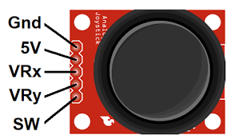
Pin Configuration
Maximum voltage - 5v
Operating Current: 3.5mA
1. GND: ground
2. +5V: 5V DC
3. VRx: voltage proportional to x position
4. VRy: voltage proportional to y position
5. SW: switch pushbutton

Slide 25
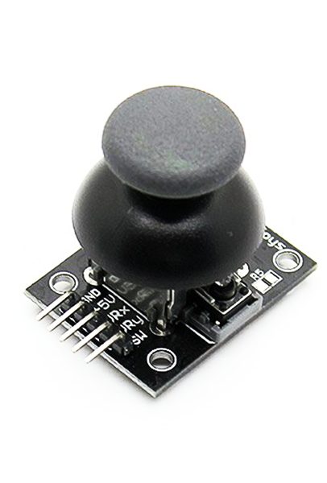
Specifications
• Directional movements are simply two potentiometers - one for each axis
• Compatible with Arduino interface
•The biaxial XY Joystick Module KY-023 applies ARDUINO
• Dimensions: 1.57 in x 1.02 in x 1.26 in (4.0 cm x 2.6 cm x 3.2 cm
• 5 Pin
• Color: Black
Data Sheet of Joystick

Slide 26
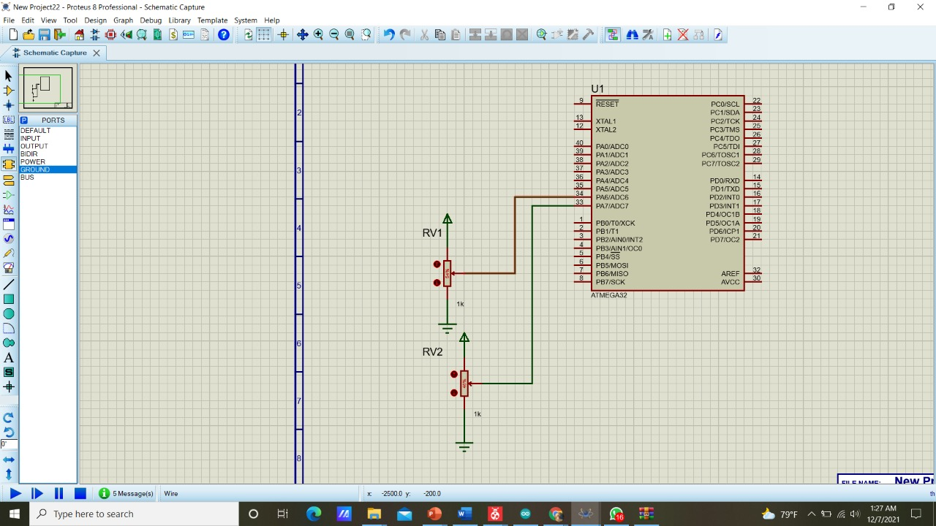
Joystick Circuit Diagram

Slide 27
The part I got in this project was the stepper motor. The stepper motor moves and stops the wheelchair. I have some understanding of the functionality of the stepper motor, the pin description and their specifications.

Slide 28
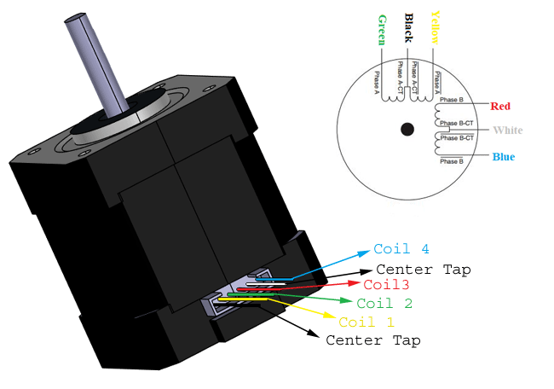
NEMA 17 Stepper Motor
Specifications
Rated Voltage: 12V DC
Current: 1.2A at 4V
Step Angle: 1.8 deg.
No. of Phases: 4
Motor Length: 1.54 inches
4-wire, 8 inch lead
200 steps per revolution, 1.8 degrees
Operating Temperature: -10 to 40 °C
Data Sheet of Stepper Motors

Slide 29
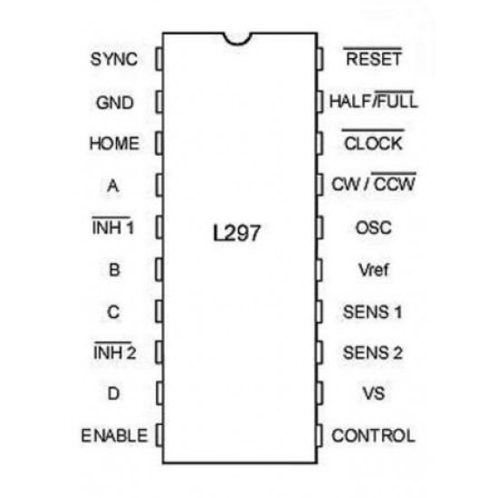
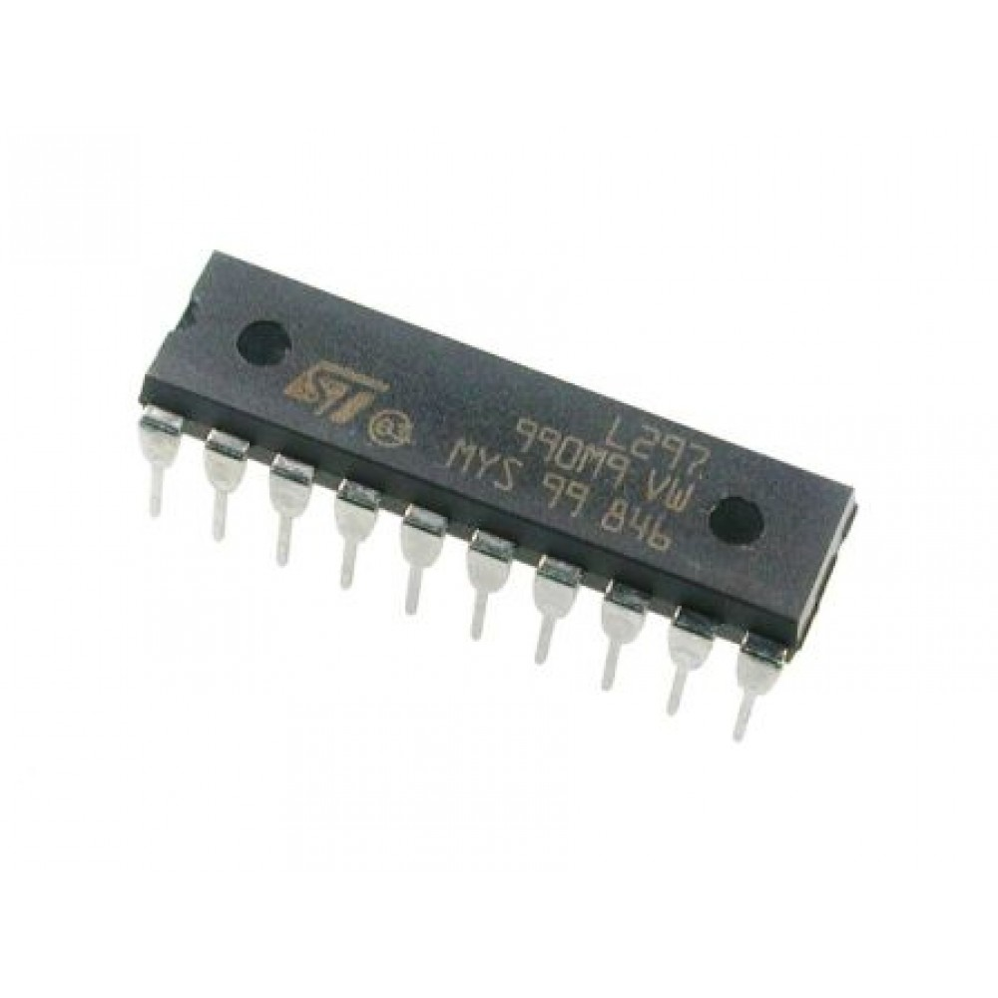
L297 Stepper Motor Driver
Specifications
Maximum Supply Voltage : 7V
Minimum Supply Voltage : 4.75V
Operating Temperature Max: 150°C
Operating Temperature Min: - 40°C
Data Sheet of Motor Driver

Slide 30
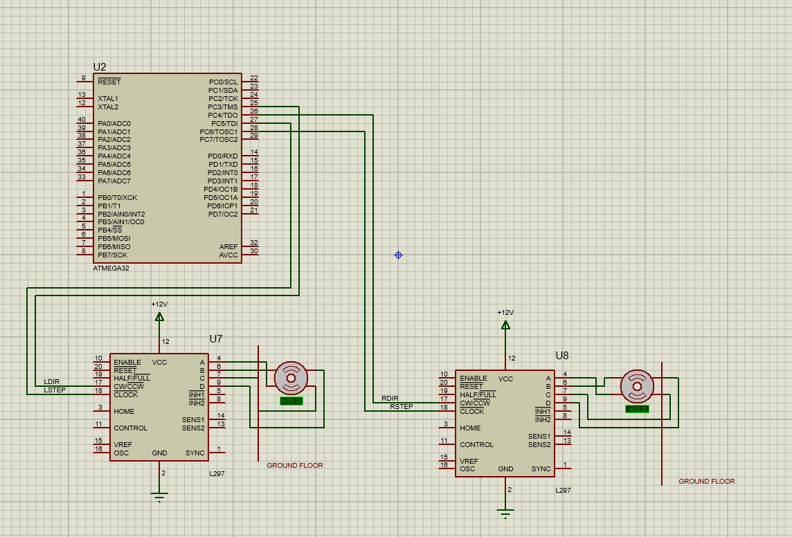
Stepper Motor Circuit Diagram

Slide 31
Thank You
Questions

